Slide 1
By Krishna K Kovalluri 6 May 2022
iMDM / EiMP - Overview

Slide 2
What Topics Covered
What is EiMP
Why EiMP
What is Golden Record
Golden Rule - Structure
EiMP – Intake Process
EiMP – Architecture
EiMP – Internal Processes
EiMP – Matching Process
EiMP – Split & Merge Process
EiMP – Survivorship Rules
EiMP – Consumer Processes
EiMP – Further Help

Slide 3
What is EiMP
Enterprise Individual Mastering Platform (EiMP) is a Master Data Management Identity Solution, used to aggregate UHG population data in a consumer centric enterprise tool. The name of this EiMP application was iMDM (Individual Master Data Management) earlier, so you will find some traces of iMDM at lot of places.
EiMP uniquely identify an individual based on demographic data collected from many different source systems.
It uses a probabilistic matching algorithm to determine if source records apply to the same individual.
Each unique individual is assigned a unique identifier Entity ID / Enterprise ID (EID).
Individual data is refined and consolidated into a master set of data. The result is a high-quality Golden Record with an Enterprise Keychain of system identifiers.
EID is linked to any identifiers in the source system records to create a keychain of identifiers. This keychain can be used to determine if records from many different systems refer to the same individual.
EiMP also creates a composite record of demographic elements from all available source systems is known as Golden Record. Determinations of which values are included in the golden record are determined by a set of Survivorship Rules. The golden record represents the best picture of an individual’s demographic data.

Slide 4
Why EiMP?
EiMP Platform Features:
Person ID Repository: Repository of the Enterprise IDs, and linkages to all the individual identity keys (i.e. application generated unique identifiers) maintained throughout the enterprise.
Person ID Matching: The Matching Service to match individual records from any source based on the rules which run on the EiMP platform. The EiMP team maintains and governs these rules and provide integration with the Person ID Repository.
Person ID Services: Real-time services for retrieving Entity IDs and their linkages to the source specific individual keys/IDs.
Golden Record Repository: Repository for the “best aggregate information” (demographic, contact info, etc.) about each individual, across all sources of information which define them.
Golden Record Survivorship Rules: The rules which govern the individual Golden Records maintaining their uniqueness. The EiMP Platform executes and manage those rules .

Slide 5
Why EiMP? (Contd…)
Golden Record Services: Real-time and batch services to intake individual attributes from existing applications / data stores, push the enterprise golden record attributes back into these systems upon matching, notification of linkage issue resolutions, and linkages to the individual Golden Record Repository.
Identity Attribute Standardization & Validation Rules: Uniform and universal quality rules applied to the attributes that we match individuals based on data across all sources of identity. This includes the technologies to apply these rules and report on quality metrics, as well as the teams to enforce and maintain them.
Identity Merge/Split Resolution & Notifications Interface: Technology integration mechanism to publish changes in individual identity linkages / key relationships to downstream systems so that they can proactively update (where needed) their corresponding identity linkages to minimize impact to the individual and downstream processes.
Individual Identity Business Operations and Support: Cross-functional teams, tooling, and processes across the entirety of the enterprise EiMP solution. It includes monitoring and enforcement of SLAs, operational reporting, issues management & communications, and issue resolution, including working with upstream portions of the process to address individual data issues at the source.

Slide 6
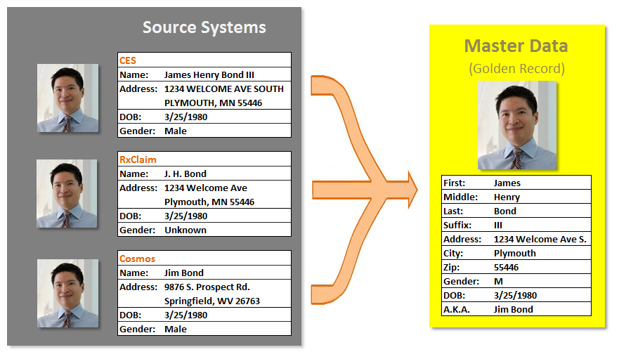
What is Golden Record
Golden record is a group of matched records (from separate source systems) that are reduced to a singular set of Master Data, represented with an Entity ID (EID).
The data ingested has already undergone name and address standardization, validation, data quality review, and governance assessments, in-order to represent the best available version of the data.
Attributes such as First Name, Last Name, Gender, SSN, DOB, Home Phone & Primary Address make up an individual’s data record. Multiple records that represent the same individual can be matched, merged and generate an entity.

Slide 7
Golden Record Structure
Golden Record supports XML and JSON (AVRO Schema based) formats.
EiMP does not produce all the attributes of JSON in XML due to replacement of IBM Initiate Matching Engine.
EiMP produces data of Eligibility Canonical Model (ECM) V3 of HCP and Patient Record in FHIR structure.
EiMP produces GR with following key attributes:
Root Level Attributes Object/Section | Description
active | Its Boolean type, indicates the GR is available or deleted.
demographicInfo | It contains core attributes of an individual like DOB, gender, SSN, Language, Married etc.
electronicAddresses | It contains Email addresses, their preferences etc.
masterIndividualIdentifier | Its Entity ID (EID) of this Golden Record.
lastUpdated | It contains latest Timestamp of source record.
partyLinks | It contains associated source records details.

Slide 8
Golden Record Structure – Contd…
Root Level Attributes Object/Section | Description
personNames | It contains names of the individual.
postalAddresses | It contains list of Postal Addresses of the individual.
socialSecurityNumber | It contains SSN of the individual.
telephoneNumbers | It contains list of Telephone Numbers of the individual, with their preference.
additionalObjects | It contains details like Ethnicity, Language, Race etc
masterIdentifiers/healthcareIdentifiers | It contains data like memberId, subscriberId, groupId, carrierId, policyNumber etc. from sources.
masterIdentifiers/keyChainIdentifiers | It contains all associated Enterprise Identifiers used as Keychains to access the unique individual.
masterIdentifiers/sourceSystemIdentifiers | It contains list of all the associated source systems.
security | It contains the list of source systems with their consuming Apps access level.

Slide 9
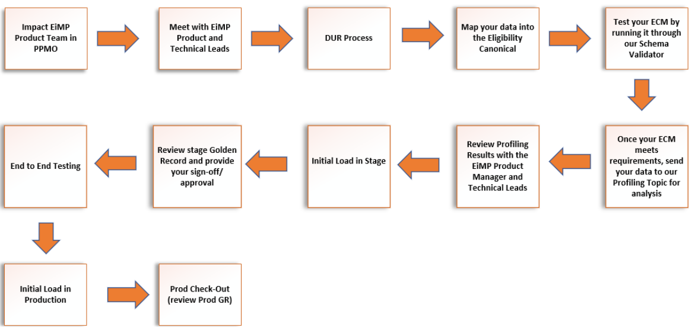
EiMP – Intake Process
EiMP supports ECM V3 of HCP
EiMP runs through Schema Validator for validating ingested data against ECM, reports the gaps in Data Mapping.
EiMP runs through the Profiler to verify the received data quality matches with the defined business rules and requirements.
Review of constant Profiling results allows refining the Business Rules at regular intervals.

Slide 10
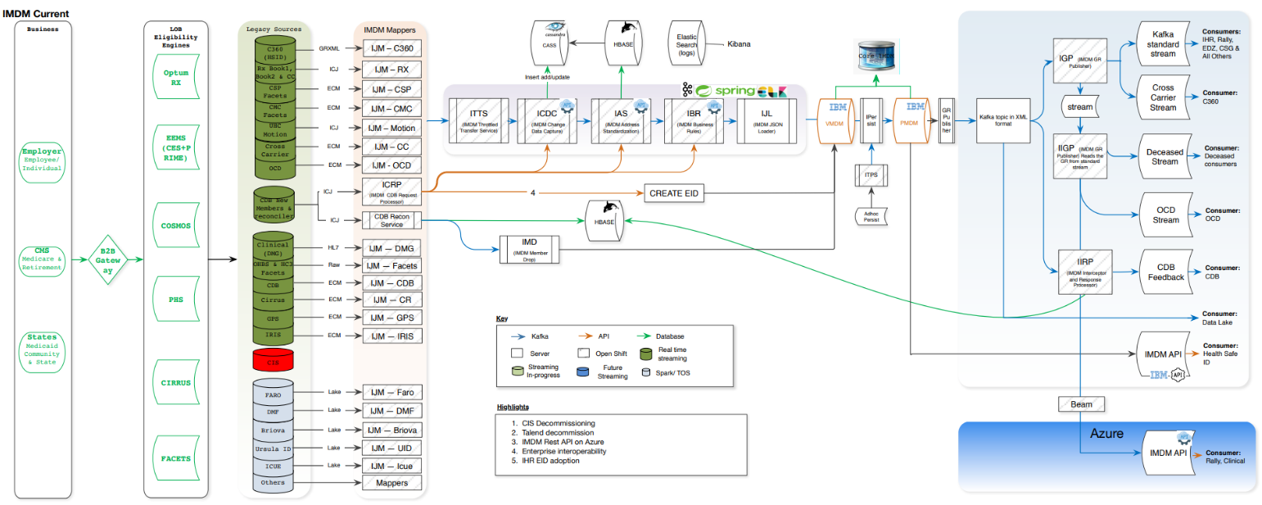
EiMP - Architecture

Slide 11
EiMP – Internal Processes
EiMP Process | Description
iMDM Mapper | It maps data from source schema received through Kafka, to ECM of HCP.
iMDM Throttled Transfer Service | It regulates the data inflow into EiMP to the desired rate. Currently EiMP supports 200TPS, and this process regulates data flow if received >200.
iMDM Change Data Capture | This process accepts data change only in Demographic section, not in any other sections of the data.
iMDM Address Standardization | It verifies the given address against the NCOA (National Change Of Address) of USPS and receives current address through ECG interface.
iMDM Business Rules | It validates the given data elements against the defined business rules and allows the data record be accepted / rejected.
iMDM Data Loader | It converts the incoming data after standardization of address to the ECM format and move it to the Kafka Topic for further processing.
iMDM Matching Engine | The Health Care Matrix (HCM) process matches the data against the existing records, applies Split/Merge process and generates unique record (Golden Record). This new Service is named as SCEPter.
iMDM Survivorship Rules | The defined Survivorship rules will be applied on the data, which may be reviewed for further analysis.

Slide 12
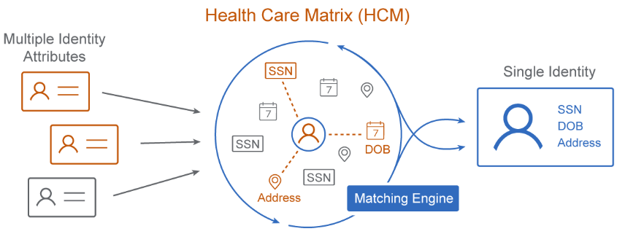
EiMP – Matching Process
Health Care Matrix (HCM) process matches incoming data against the stored records to identify the unique data elements and prepare Golden Record.
HCM uses entity agnostic machine learning algorithms, which uses statistical analysis, probabilistic and transitive matching logic.
HCM also uses split and merge process to either combine with existing record or create new unique record with new EID.
HCM uses new matching application called SCEPter, replacing the existing IBM Initiate application.
HCM delivers data with HIPAA compliancy, follows FHIR data format and HL7 standard.

Slide 13
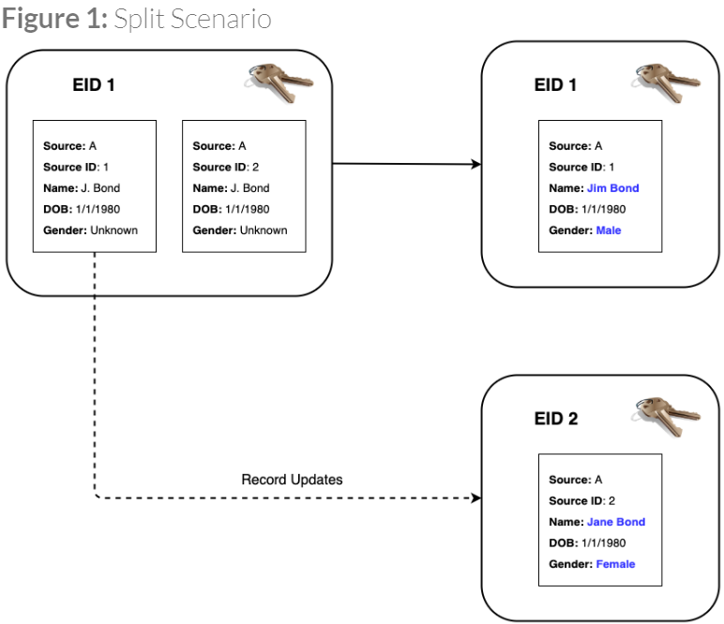
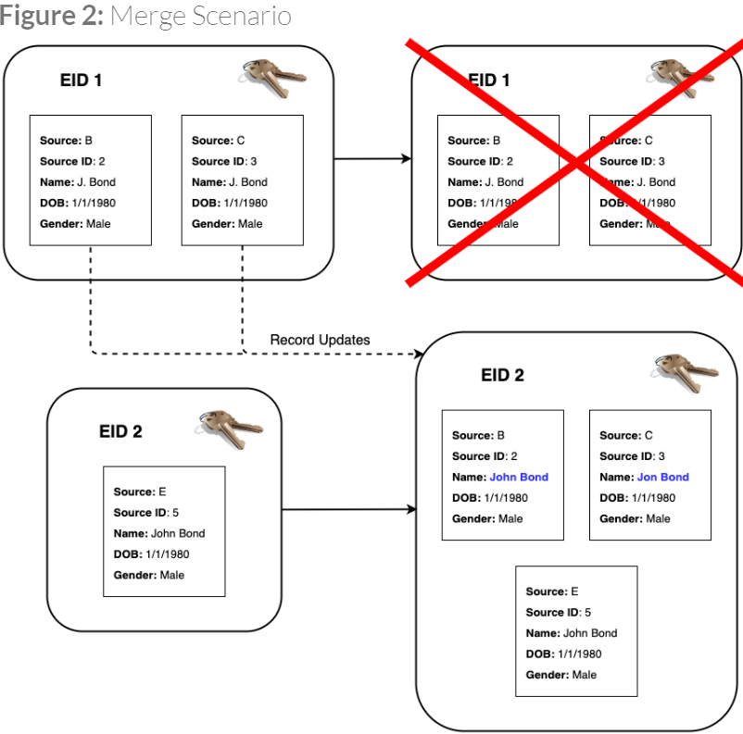
EiMP – Split & Merge Process
A split may occur when inaccurate data such as SSN / DOB / Gender etc. are updated from a source. EiMP will re-evaluate the new data and determine if the member is still tied to the same individual or not. The record might be separated (split) from each other. One of the member records might become a singleton record or merge into another individual.
A merge scenario is common when new attributes such as address, phone and email are brought in from a source. EiMP will re-evaluate the new data and determine if another individual shares the same data. If EiMP algorithm determines that it does, it will join (merge) the two individual records together into one.

Slide 14
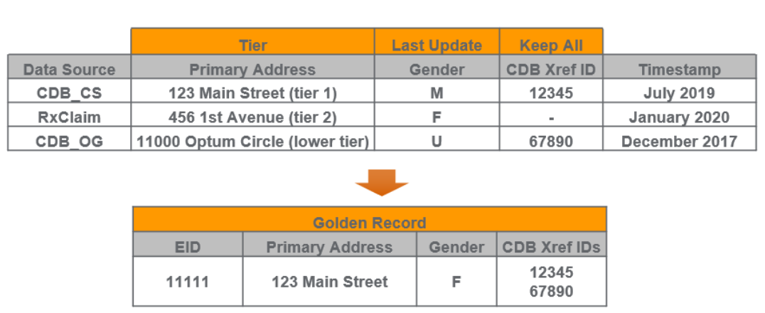
EiMP - Survivorship Rules
EiMP survives data to the golden record on an attribute basis. Each attribute is assigned to one of three survivorship rules.
All survivorship rules are approved by a governance council of stakeholders from each Line Of Business (LOB). Governance meetings are hosted at regular intervals by the EiMP team.
Survivorship Rule Types
Tier | A hierarchy of sources is created based on the confidence level of the data that source provides. MDM will survive data for the attribute from the highest ranked source available.
Last Updated | The data from the record with the most recent update, regardless of source, will be survived.
Keep All Unique | All unique values of an attribute from across the member's different records will be survived.
14

Slide 15
EiMP – Consumer Processes
The EiMP Golden Record is available for consumption in two different patterns: Kafka Streaming or Graph API.
Golden Record consumption through Kafka Stream:
The Golden Record topic in non-prod and prod on-premise is through the Kafka-as-a-Service clusters (kaas-alpha and kaas-prod).
The Golden Record can also be consumed from Azure Topics in both non-prod and prod environments, and details may be taken from the EiMP Product Team.
The User Information may be accessed through User Service API:
This Service is based on REST, and it will be fastest to fetch User Data (not GR)
It will provide only the Demographic info and the associated ID’s of the User
It can accept an ID like EID / HSID / DOB with an ID etc. to fetch one unique user record
It will fetch all associated User Records if multiple Search ID’s provided in the request.
This Service is free to use, no chargebacks.
The User Information may be accessed through GraphQL API:
This Service is based on GraphQL API, runs on the Golden Record (MasterIdentifier)
It can accept few Identifiers and provide the required User Info from GR
The Request params can be EID OR Big 3 and any other Identifier(s) if available, and Response can be any set of params from the Golden Record.

Slide 16
EiMP – Further Help
The detailed information about EiMP and its related Technologies may be found here:
EiMP Documentation: Enterprise Individual Mastering Platform (optum.com)
EiMP Matching Process: Health Care Matrix (optum.com)
EiMP On-boarding Process: Instructions and Checklist - Enterprise Individual Mastering Platform (optum.com)
EiMP User Service: HCP/UserService.md at master · hcp-poa/HCP (optum.com)
EiMP GraphQL API: HCP Graph API Overview · HCP Graph API (optum.com)
Following people of EiMP may be contacted for further help: Teams & Contact Info - Enterprise Individual Mastering Platform (optum.com)

Slide 17
Thank you

